Slide 1
GRAPHS

Slide 2
What is a Graph?
Informally a graph is a set of nodes joined by a set of lines or arrows.
1
3
1
2
3
2
4
5
6
4
5
6

Slide 3
Definitions Graph is a set of Vertices and Edges G:=(V, E)
Vertex
Basic Element
Drawn as a node or a dot.
Vertex set of G is usually denoted by V(G), or V
Edge
A set of two elements
Drawn as a line connecting two vertices, called end vertices, or endpoints.
The edge set of G is usually denoted by E(G), or E.

Slide 4
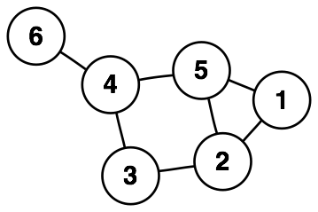
Example
V:={1,2,3,4,5,6}
E:={{1,2},{1,5},{2,3},{2,5},{3,4},{4,5},{4,6}}

Slide 5
Simple Graphs
Simple graphs are graphs without multiple edges or self-loops.

Slide 6
Path
A path is a sequence of vertices such that there is an edge from each vertex to its successor.
A path is simple if each vertex is distinct.
1
3
A
B
C
2
Cycle
4
5
6
D
E
F
Cycle
Unreachable
Simple path from 1 to 5 = [ 1, 2, 4, 5 ]
Our text’s alternates the vertices and edges.
If there is path p from u to v then we say v is reachable from u via p.

Slide 7
Cycle
A path from a vertex to itself is called a cycle.
A graph is called cyclic if it contains a cycle;
otherwise it is called acyclic
1
3
A
B
C
2
Cycle
4
5
6
D
E
F
Cycle
Unreachable

Slide 8
Connectivity
is connected if
you can get from any node to any other by following a sequence of edges OR
any two nodes are connected by a path.
A directed graph is strongly connected if there is a directed path from any node to any other node.

Slide 9
A weighted graph
is a graph for which each edge has an associated weight, usually given by a weight function w: E → R.
1.2
2
1
2
3
1
2
3
.2
.5
1.5
5
3
.3
1
4
5
6
4
5
6
.5

Slide 10
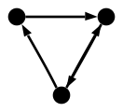
Directed Graph (digraph)
Edges have directions
An edge is an ordered pair of nodes

Slide 11
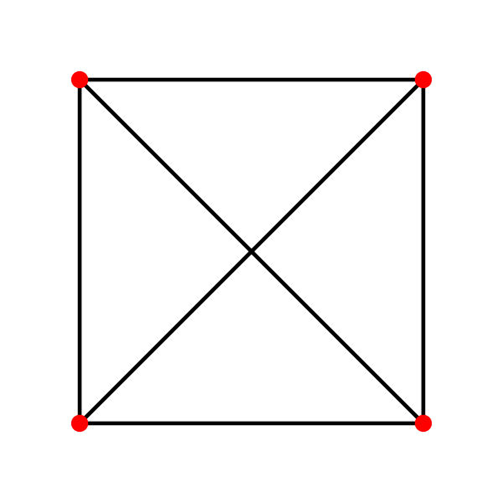

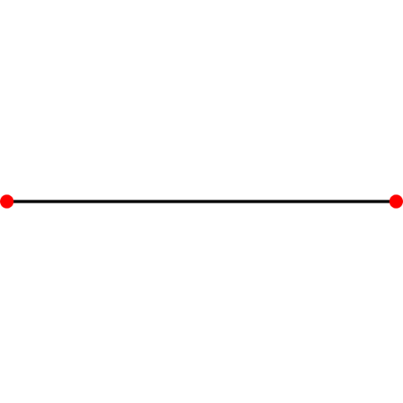
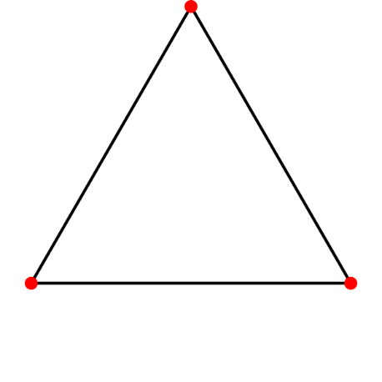
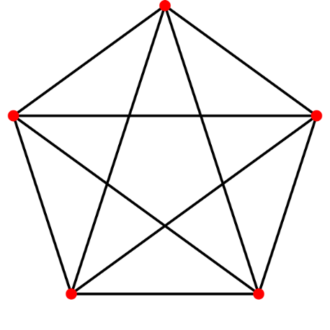
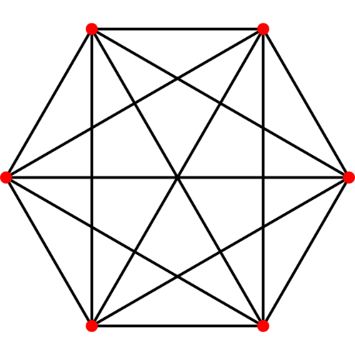
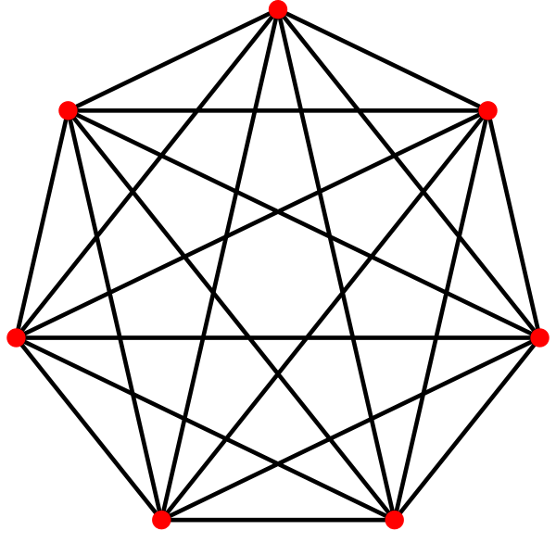
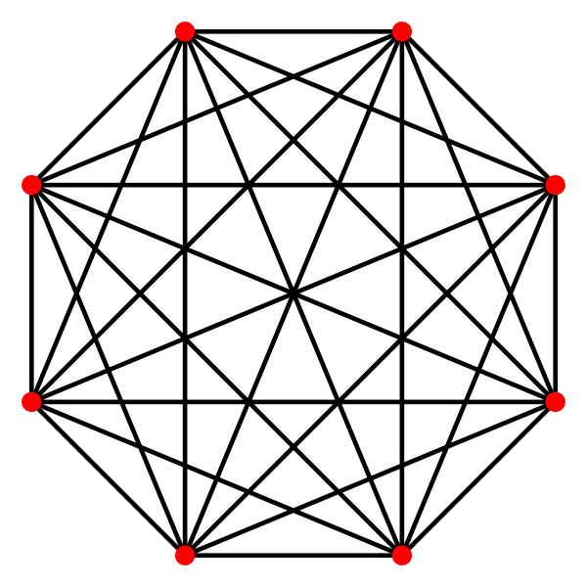
Complete Graph
Denoted K_{n}
Every pair of vertices are adjacent
Has n(n-1) edges

Slide 12
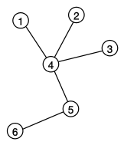
Tree
Connected Acyclic Graph
Two nodes have exactly one path between them

Slide 13
Degree
A
B
C
D
E
F
The degree of B is 2.
Number of edges incident on a node

Slide 14
Degree (Directed Graphs)
1
2
4
5
The in degree of 2 is 2 and the out degree of 2 is 3.
In degree: Number of edges entering
Out degree: Number of edges leaving
Degree = indegree + outdegree

Slide 15
Degree: Simple Facts
If G is a digraph with m edges, then Σ indeg(v) = Σ outdeg(v) = m = |E |
If G is a graph with m edges, then Σ deg(v) = 2m = 2 |E |
Number of Odd degree Nodes is even

Slide 16
Representation (Matrix)
Adjacency Matrix
V x V matrix
Boolean values (adjacent or not) Or Edge Weights

Slide 17
Adjacency Matrix Representation for a Directed Graph
1 2 3 4 5
1
2
3
4
5
0 1 0 0 1
1
2
0 0 1 1 1
0 0 0 1 0
3
0 0 0 0 1
5
4
0 0 0 0 0

Slide 18
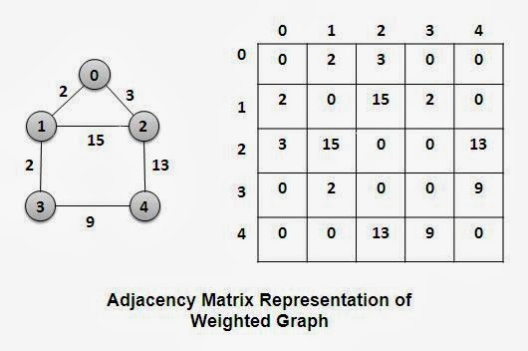

Slide 19
Adjacency-list representation
an array of |V | lists, one for each vertex in V.
For each u ∈ V , ADJ [ u ] points to all its adjacent vertices.

Slide 20
Adjacency-list representation for a directed graph.
1
2
5
1
2
2
5
3
4
3
3
4
5
4
4
5
5
5

Slide 21
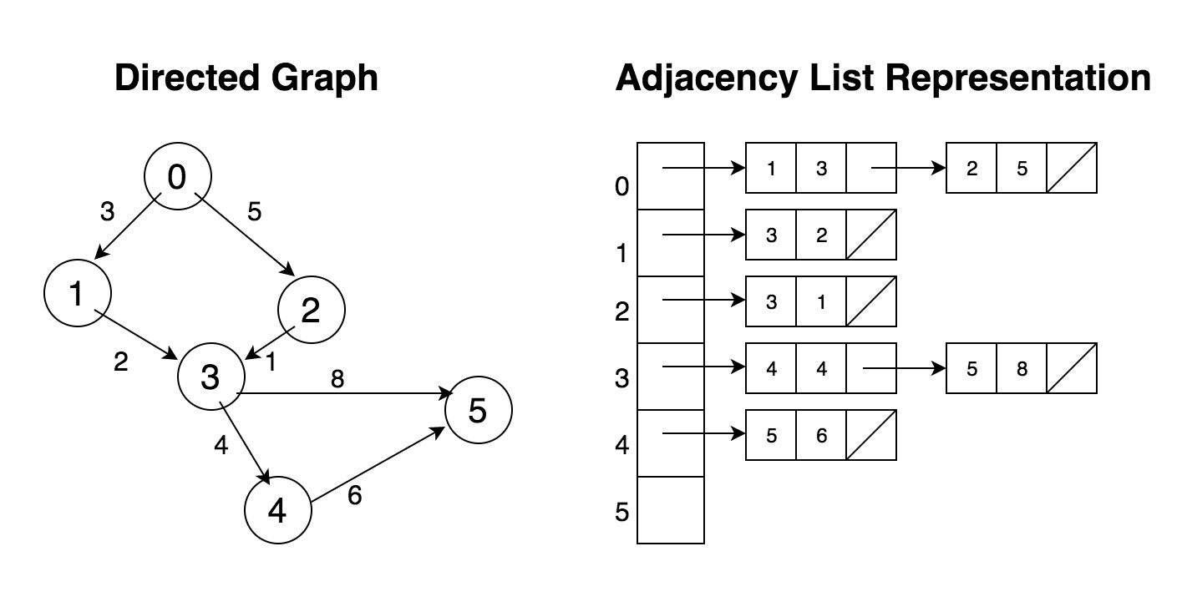

Slide 22
Adjacency Matrix Representation
Advantage:
Saves space for:
Dense graphs.
Small unweighted graphs using 1 bit per edge.
Check for existence of an edge in θ(1)
Disadvantage:
Traverse all the edges that start at v, in θ(|V|)

Slide 23
Adjacency Matrix Representation
Storage
Θ( | V |²) ( We usually just write, Θ( V ²) )
For undirected graphs you can save storage (only 1/2(V²)) by noticing the adjacency matrix of an undirected graph is symmetric. How?
Easy to handle weighted graphs. How?

Slide 24
Adjacency lists
Advantage:
Saves space for sparse graphs. Most graphs are sparse.
Traverse all the edges that start at v, in θ(degree(v))
Disadvantage:
Check for existence of an edge (v, u) in worst case time θ(degree(v))

Slide 25
GRAPH TRAVERSAL

Slide 26
Graph traversals/search
Graph traversal means visiting every vertex and edge exactly once in a well-defined order. While using certain graph algorithms, you must ensure that each vertex of the graph is visited exactly once. The order in which the vertices are visited are important and may depend upon the algorithm or question that you are solving.
During a traversal, it is important that you track which vertices have been visited. The most common way of tracking vertices is to mark them.

Slide 27
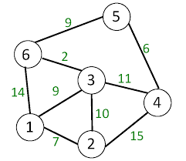
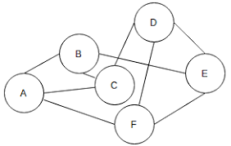
How to Traverse vertices of these graphs :

Slide 28
Breadth First Search
BFS is a traversing algorithm where you should start traversing from a selected node (source or starting node) and traverse the graph level wise thus exploring the neighbour nodes (nodes which are directly connected to source node). You must then move towards the next-level neighbour nodes.
As the name BFS suggests, you are required to traverse the graph breadthwise as follows:
First move horizontally and visit all the nodes of the current layer
Move to the next layer

Slide 29
BFS Traversal of these graphs :
1, 6, 3, 2, 5, 4
A,B, C, F, E, D

Slide 30
BFS -ALGO
BFS (G, s) //Where G is the graph and s is the source node
let Q be queue.
Q.enqueue( s ) //Inserting s in queue until all its neighbour vertices are marked.
mark s as visited.
while ( Q is not empty)
//Removing that vertex from queue, whose neighbour will be visited now
v = Q.dequeue( )
//processing all the neighbours of v
for all neighbours w of v in Graph G
if w is not visited
Q.enqueue( w ) //Stores w in Q to further visit its neighbour
mark w as visited.

Slide 31
Depth First Search
The DFS algorithm is a recursive algorithm that uses the idea of backtracking. It involves exhaustive searches of all the nodes by going ahead, if possible, else by backtracking.
Here, the word backtrack means that when you are moving forward and there are no more nodes along the current path, you move backwards on the same path to find nodes to traverse. All the nodes will be visited on the current path till all the unvisited nodes have been traversed after which the next path will be selected.

Slide 32
This recursive nature of DFS can be implemented using stacks. The basic idea is as follows: Pick a starting node and push all its adjacent nodes into a stack. Pop a node from stack to select the next node to visit and push all its adjacent nodes into a stack. Repeat this process until the stack is empty. However, ensure that the nodes that are visited are marked. This will prevent you from visiting the same node more than once. If you do not mark the nodes that are visited and you visit the same node more than once, you may end up in an infinite loop.

Slide 33
DFS
Rule 1 − Visit the adjacent unvisited vertex. Mark it as visited. Display it. Push it in a stack.
Rule 2 − If no adjacent vertex is found, pop up a vertex from the stack. (It will pop up all the vertices from the stack, which do not have adjacent vertices.)
Rule 3 − Repeat Rule 1 and Rule 2 until the stack is empty.

Slide 34
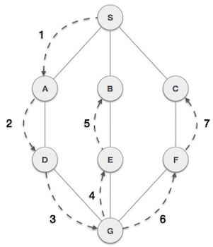

Slide 35
DFS-iterative (G, s): //Where G is graph and s is source vertex
let S be stack
S.push( s ) //Inserting s in stack
mark s as visited.
while ( S is not empty):
//Pop a vertex from stack to visit next
v = pop(S )
//Push all the neighbours of v in stack that are not visited
for all neighbours w of v in Graph G:
if w is not visited :
S.push( w )
mark w as visited

Slide 36
DFS Traversal of these graphs :
1, 2, 3, 4, 5,6
A, B, C E, D, F

Slide 37
Applications of Graphs

Slide 38
Famous problems
In 1852 Francis Guthrie posed the “four color problem” which asks if it is possible to color, using only four colors, any map of countries in such a way as to prevent two bordering countries from having the same color.
This problem, which was only solved a century later in 1976 by Kenneth Appel and Wolfgang Haken, can be considered the birth of graph theory.

Slide 39
Connector problem
Design a railway network connecting a number of cities, with a minimum possible construction cost.
Or electrical network, cable TV, gas, etc.

Slide 40
Famous problems
“The traveling salesman problem”
A traveling salesman is to visit a number of cities; how to plan the trip so every city is visited once and just once and the whole trip is as short as possible ?

Slide 41
Travelling salesman problem
Delhi
Mumbai
Hyderabad
Bangalore
Chennai
Madurai
A salesperson begins in Bangalore, has to visit all the cities, and return to Bangalore in a shortest possible distance. (or time, or cost)

Slide 42

Vehicle Routing
Need to transport n children to m bus stops across the city.
There are k buses, each bus j has capacity cj. Each km has a cost. (time).
Problem: Route the buses the total cost (or time) is minimized.

Slide 43
Chinese Postman Problem
A postman begins in the post office, has to traverse all the streets, and returns to the post office in a shortest possible distance.
P.O.

Slide 44
Examples
Cost of wiring electronic components
Shortest route between two cities.
Shortest distance between all pairs of cities in a road atlas.
Matching / Resource Allocation
Task scheduling
Visibility / Coverage

Slide 45
Examples
Flow of material
liquid flowing through pipes
current through electrical networks
information through communication networks
parts through an assembly line
In Operating systems to model resource handling (deadlock problems)
In compilers for parsing and optimizing the code.

Slide 46
Traffic network design problems
Cities have a growth of vehicle fleets
Good mobility and accessibility to goods, labour, and markets permit and encourage urban concentration.
Good transportation is necessary for jobs, business, basic utilities.
Transportation usually occupies 20-40% of city’s physical space
Problems: Change traffic patterns to allow a more efficient flow of transportation.
Design a traffic network which is fault-tolerant.

Slide 47
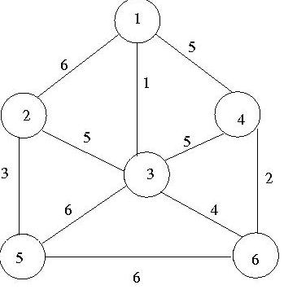
BFS and DFS of the given Graph

Slide 48
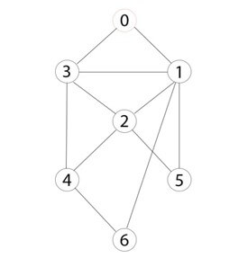
BFS and DFS starting at 0

Slide 49
Spanning Tree of a Graph

Slide 50
Spanning Tree
Spanning Trees: A subgraph T of a undirected graph G(V,E) is a spanning tree of G if it is a tree and contains every vertex of G

Slide 51
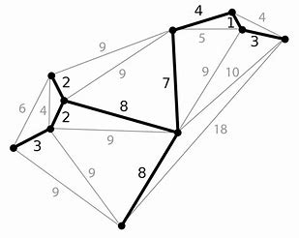
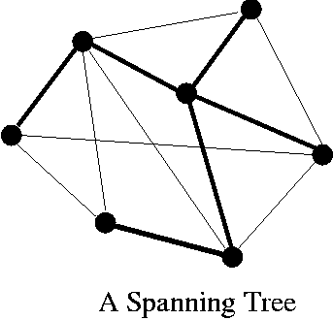

Slide 52
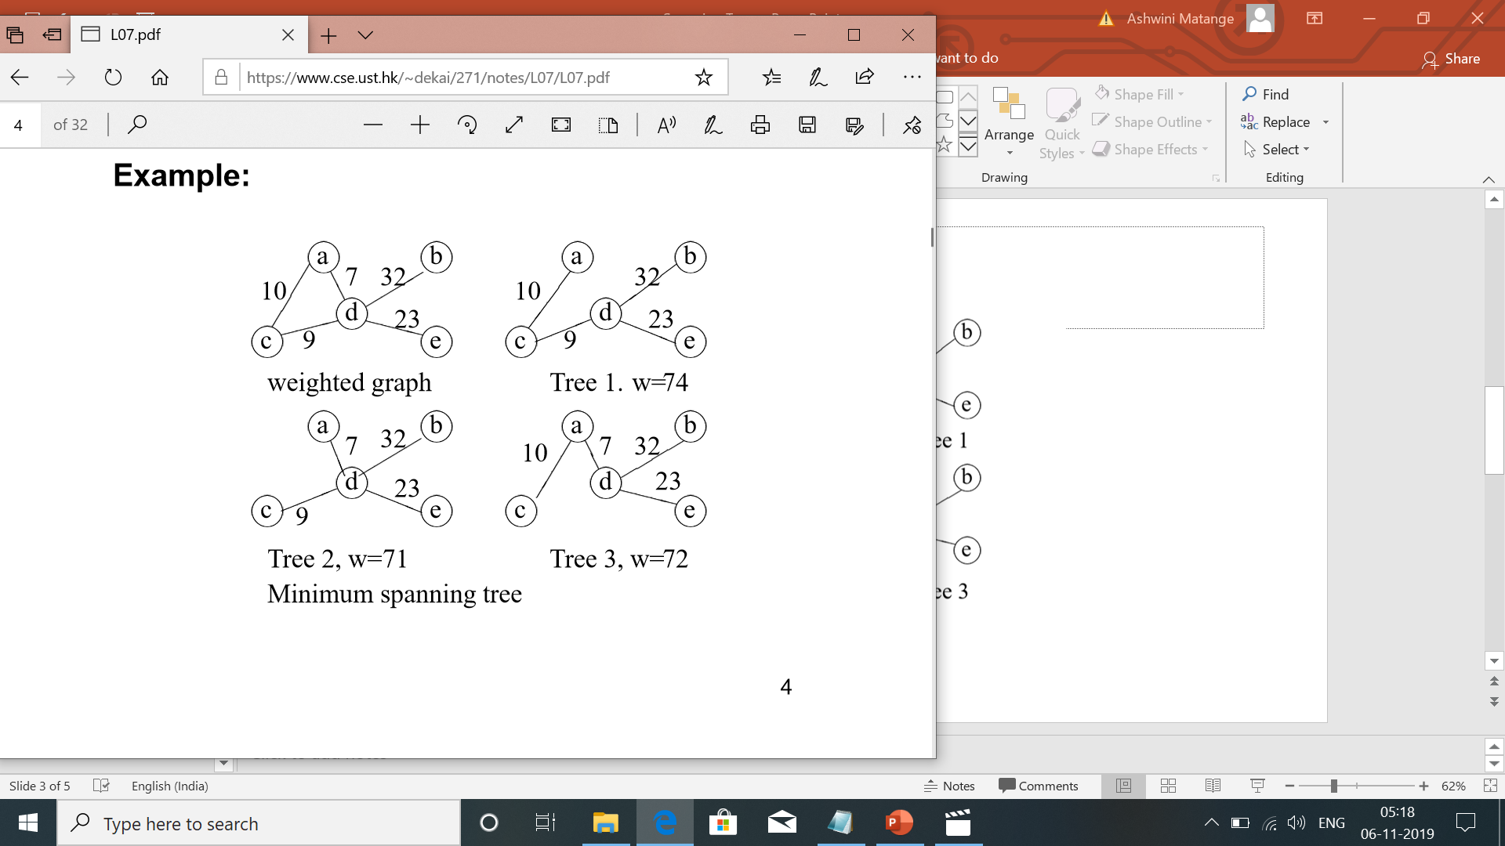
Find Spanning(s) Trees

Slide 54
Minimum Spanning Tree
A Minimum Spanning Tree in an undirected connected weighted graph is a spanning tree of minimum weight (among all spanning trees).

Slide 55
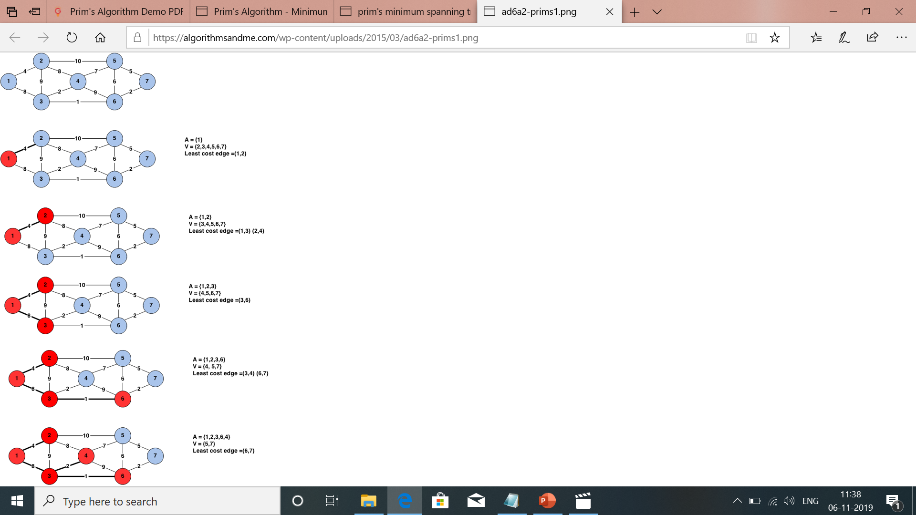
Prim’s Minimum Spanning tree algorithm

Slide 61
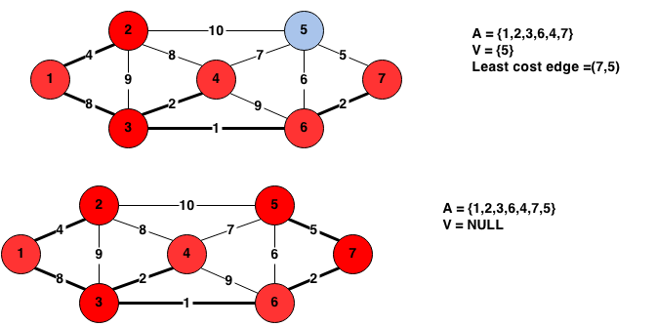

Slide 62
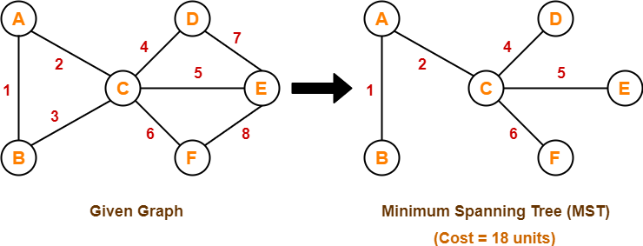
Find Minimum Spanning Tree using Prim’s Algo

Slide 64
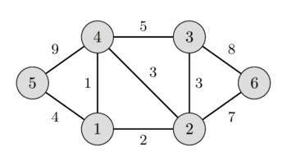
Find Minimum Spanning Tree using Prim’s Algorithm

Slide 65
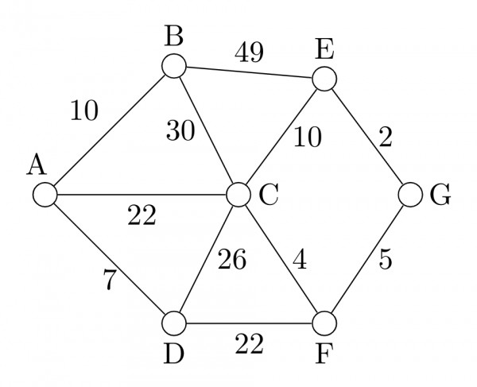
Find Minimum Spanning Tree

